Slide 1



ADAPTIVE HCI
Real-time Stabilization and 3D Reconstruction of Hand Gestures and Finger Movement Traces Using LED-Equipped Gloves
Presented by Team 5: Deniz Acikbas, Soham Naik, Zaynab Mourtada, Alan Raj

Slide 2


Project Overview
This project focuses on developing a mobile application that captures, stabilizes, and smooths virtual hand movements for patients with Parkinson’s disease, specifically for virtual writing, while also converting it into text.

Slide 3
Competitive Analysis
Competitor: "Trajectory-Based Air-Writing Recognition Using Deep Neural Network and Depth Sensor"
Technology Used
3D depth camera for fingertip tracking
Deep learning models: LSTM and CNN
Data normalization (nearest neighbor, root point translation)
Strengths
Achieved 99.32% accuracy on the 6DMG dataset
Developed a large dataset (21,000 trajectories) for deep learning applications
Robust recognition under different writing styles and conditions
Weaknesses
Requires a depth camera (specialized hardware)
Shaky trajectories due to lack of a fixed writing boundary
Offline approach (push-to-write) may limit real-time applications
Comparison with Our Approach
Our system aims for real-time air-writing recognition
Focus on enhanced stabilization techniques (Kalman filtering, ARCore integration)
More accessible hardware (camera-based tracking without requiring depth sensors)
Potential for better user experience in AR/VR applications

Slide 4

SYSTEM WORKFLOW

Slide 5
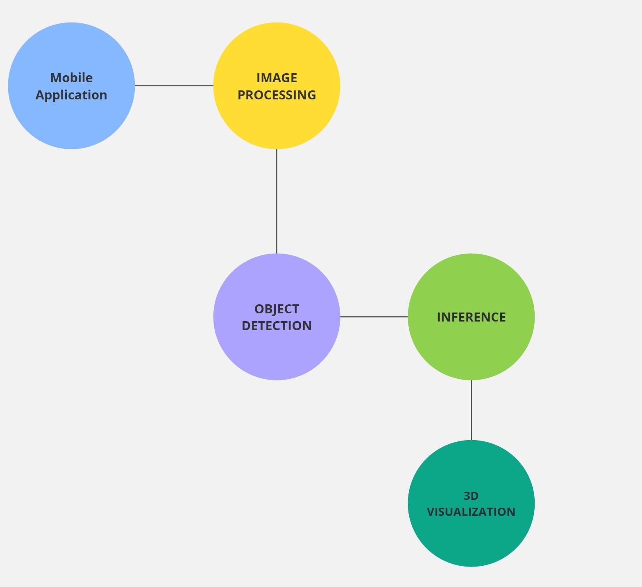
OVERALL SYSTEM
Prerequisites:
User wears LED gloves
User access mobile application

Slide 6
FUNCTIONALITY LIST

Slide 7
FUNCTIONALITY LIST
Mobile Application
LED GLOVES
Image Processing
Language: C
Hardware: Arduino Nano
Controls brightness of gloves using PWM
Each user has a distinct pattern
Stack: Kotlin, Android Studio
User draws in front of camera, app sends to other modules, returning smoothed writing, text inference, and 3D visualization
Tech: Camera 2 API, OpenCV, Kalman Filter
Reduces noise, smoothes writing, and processes input for ML
Machine Learning
3D VISUALIZATION
Tech: LSTM model, YOLOv8, TFLite
YOLOv8 detects nodes/objects
LSTM recognizes digits/characters for text inference
Tech: ARCore + OpenGL ES
Visualizes the output from the ML module in 3D VR mode

Slide 8
Processing & You Only Look Once (YOLO)
Pre-Processing (Preparing Input for YOLO)
YOLO Inference (Real-Time Object Detection)
Post-Processing (Refining & Tracking)
Smooth tracking using Kalman Filter & Spline Interpolation.
Output:
Optimized detection results displayed on the video frame in real-time.
Tracking data stored for Text Inference or AR visualization.

Slide 9
3D VISUALIZATION
Tech:
ARCore: Enables augmented reality features by combining real-world camera feed with 3D visuals.
OpenGL ES: Renders data allowing real-time visualizations.
Process:
ML Module Output: Tracks LED glove movements in 3D space and outputs coordinates for the air-written letters.
OpenGL ES Rendering: Creates smooth 3D visualizations
ARCore Integration: Uses real-time camera and AR features to display 3D path visualization of the letters.

Slide 10
PROTOTYPE FEATURES
Real-Time 3D Path Visualization
Displays path in real-time directly to screen.
Exports a text file describing the path for use in ARCore and OpenGL ES to display the written path in AR/VR
Air-Writing Detection & Tracking
YOLO-based tracking system identifies LED and captures finger movements.
Kalman filtering and Cubic Spline Interpolation applied to smooth trajectory and reduce noise
Demo Air Text inference
User Interaction & AR Mode
Enables users to write freely in the air without physical contact.
Display letters in AR/VR mode for an immersive experience.

Slide 11
LIVE DEMO

Slide 12
FUTURE IMPROVEMENTS
Expanded ML Capabilities
Train deep learning models for personalized handwriting recognition.
Collect more training and test data to improve model accuracy

